Slide 1
PROJECT TITLE
PSCS_282_AI-Driven Crop Disease Prediction and Management System
CSE7101- Capstone Project
Review-2
Batch Number: COM_22
Roll Number | Student Name
20221COM0084 | Vishnu M
20221COM0096 | R Akash
20221COM0099 | Jagadish T S
Under the Supervision of,
Mr.Muthuraju V
Assistant Professor
School of Computer Science and Engineering
Presidency University
Name of the Program: COM
Name of the HoD: Dr. Pallavi R
Name of the Program Project Coordinator: Ms. Benitha Christinal J
Name of the School Project Coordinators: Dr. Sampath A K , Dr. Geetha A

Slide 2
Content
Problem Statement & Number
Abstract
Literature Survey
Objectives
Existing Methods and Drawbacks
Proposed Method & Feasibility Study
Architecture Diagram
Modules
Hardware and Software Details
Timeline (Gantt Chart)
References

Slide 3
Problem Statement Number: PSCS_282
Organization: Presidency University – School of Computer Science and Engineering
Category (Hardware / Software / Both) : Software
Problem Description: Background: Crop diseases can devastate yields, leading to significant financial
losses for farmers. Early detection and timely intervention are crucial for effective
management. Description: Develop an AI-driven system that analyzes crop images
and environmental data to predict potential disease outbreaks. This system will
provide farmers with actionable insights and treatment recommendations to
mitigate risks. Expected Solution: A mobile and web-based application that utilizes
machine learning algorithms to identify crop diseases and suggest preventive
measures and treatments based on real-time data.

Slide 4
Abstract
Crop diseases cause significant agricultural losses, impacting both yield and farmer income. Existing detection methods are mostly manual, slow, and dependent on expert knowledge, while lacking proper treatment guidance. Recent advancements in convolutional neural networks (CNNs) have shown promising results in plant disease detection; however, most studies remain limited to controlled datasets and lack real-world deployment. To address this gap, we propose an AI-driven solution that not only detects crop diseases but also provides treatment suggestions, accessible through mobile and web platforms. As part of our current progress, we have trained a CNN-based model (plant_disease_model.h5) and integrated it with a React Native frontend and a FastAPI backend to enable real-time predictions and farmer usability.

Slide 5
Literature Survey
1) Mohanty et al. (2016) – Deep Learning for Plant Disease Detection
CNN on PlantVillage dataset (54k images), ~99% accuracy under lab conditions.
Limitation: Poor field performance; no severity or treatment support.
2) Ferentinos (2018) – Deep CNN Benchmark
Compared CNNs (ResNet, Inception, DenseNet) for crop diseases.
Limitation: Only classification accuracy; not field-deployable.
3) Khan et al. (2023) – Edge Deployment
Lightweight CNNs with pruning/quantization for mobile.
Limitation: Ignores noisy field images & rural connectivity issues.
4) Ding et al. (2023) – Prescription Recommendation
Embedding-based retrieval system for treatment guidance.
Limitation: Effectiveness depends on pesticide DB coverage.
5) Bedi et al. (2024) – PDSE-Lite (Severity Estimation)
Segmentation to estimate disease severity (% infected pixels).
Limitation: Struggles with occlusion & multi-leaf field images.
6) Wu et al. (2023) – Domain Adaptation
Field-style augmentation + unsupervised adaptation.
Limitation: Complex; performance gain depends on dataset similarity.

Slide 6
Literature Survey(contd...)
7) EfficientNet Studies (2022–2025)
High accuracy with fewer parameters (scalable).
Limitation: Heavier than MobileNet → trade-off for devices.
8) Ensemble Models (2024)
Multiple CNNs (DenseNet, EfficientNet, InceptionResNet) combined.
Limitation: Expensive computation, not mobile-friendly.
9) Explainable AI (2025)
Grad-CAM & reliability metrics improve trust.
Limitation: Explanations may confuse non-experts.
10) Knowledge-Based Systems (2021–2024)
Ontologies + rule-based reasoning for treatment.
Limitation: Hard to localize & maintain knowledge base.
11) PlantCareNet (2025) – Integrated Platform
Combines detection, severity, and treatment recommendation.
Limitation: Pilot stage; needs field validation.

Slide 7
Objectives
Develop an AI-based model (CNN/EfficientNet) for plant disease detection from leaf images.
Enhance robustness using transfer learning & domain adaptation techniques.
Implement severity estimation (e.g., % infection per leaf via segmentation).
Provide treatment recommendations through a JSON/knowledge base (future: API integration).
Deploy the system on mobile/web for farmer accessibility.
Ensure scalability by designing lightweight models for edge/mobile devices.
Increase trust with Explainable AI (Grad-CAM visualizations).

Slide 8
Existing Methods and Drawbacks
Manual Inspection
Needs experts, time-consuming, prone to errors
CNN-based Models (Mohanty, Ferentinos, etc.)
Good accuracy in lab datasets.
Drawback: Poor generalization in field conditions.
Our Current System
Model detects disease (using trained CNN).
Provides treatment suggestions from a JSON file.
Drawbacks:
Suggestions are static (limited to JSON entries).
No severity estimation yet.
Prediction takes ~2 mins (slow response).

Slide 9
Proposed Method & Feasibility Study
Proposed Method (Current Stage):
Trained CNN model (plant_disease_model.h5) for disease detection.
Frontend: React Native app for image upload.
Backend: FastAPI (hosted on Render, connected via Git).
Output: Disease name + treatment suggestion (from JSON file).
Future Enhancements:
Replace static JSON with API-based knowledge base for prescriptions.
Add severity estimation (leaf segmentation, % infection).
Optimize response time (reduce ~2 min latency).
Integrate Explainable AI (Grad-CAM) for trust.
Deploy lightweight models for mobile/edge devices.
Feasibility:
Technology: TensorFlow, FastAPI, React Native (open-source, cost-effective).
Hardware: Android smartphone + standard server.
Data: PlantVillage dataset + augmentation for field scenarios.
Deployment: Cloud-based (Render) → scalable and accessible to farmers.

Slide 10
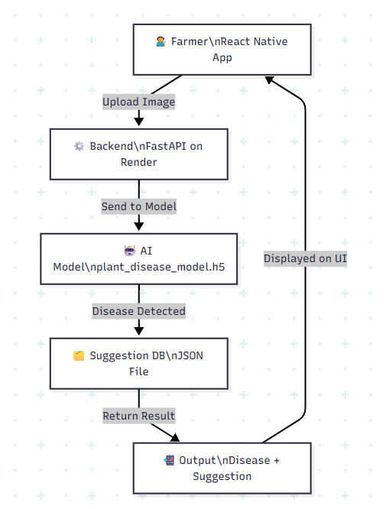
Architecture Diagram

Slide 11
Modules
1. Image Input & Preprocessing
Farmer uploads crop/leaf image via React Native app.
Preprocessing (resize, normalization).
2. Disease Detection
CNN model (plant_disease_model.h5) classifies the disease.
3. Suggestion System
Current: Treatment suggestions fetched from JSON file.
Future: API/knowledge base integration.
4. Backend API
FastAPI connects frontend with the model & suggestion system.
5. Frontend (Mobile App)
React Native app for image upload and result display.

Slide 12
Hardware and Software Details
Hardware Requirements
Android Smartphone (image capture & testing).
Laptop / Cloud Server (for model training & API hosting).
Standard Phone Camera (sufficient for disease image capture).
Software Requirements
Programming Languages: Python, JavaScript (React Native).
Libraries/Frameworks: TensorFlow/Keras, OpenCV, FastAPI.
Frontend: React Native (mobile app).
Backend: FastAPI (REST API).
Deployment Tools: GitHub, Render (cloud hosting).
Others: Google Colab (model training), JSON (suggestion storage).

Slide 13
Timeline of the Project (Gantt Chart)
Task | Week 1–2 | Week 3–4 | Week 5–6 | Week 7–8 | Week 9–10 | Week 11–12
Literature Review & Problem Analysis | ████
Dataset Collection & Preprocessing | ████ | ████
AI Model Training & Evaluation |  | ████ | ████
Backend API Development |  | ████ | ████
Mobile App (React Native) |  |  | ████ | ████
Integration (Model + API + App) |  |  |  | ████ | ████
Performance Evaluation (Latency Testing) |  |  |  | ████ | ████
Future Enhancements (Severity Estimation, Explainability, API) |  |  |  |  | ████ | ████
Final Deployment & Documentation |  |  |  |  |  | ████

Slide 14
References (IEEE Paper format)
[1] S. Mohanty, D. Hughes, and M. Salathé, “Using deep learning for image-based plant disease detection,” Frontiers in Plant Science, vol. 7, p. 1419, Oct. 2016.
[2] K. P. Ferentinos, “Deep learning models for plant disease detection and diagnosis,” Computers and Electronics in Agriculture, vol. 145, pp. 311–318, Feb. 2018.
[3] M. A. Khan, et al., “Lightweight deep learning models for plant disease detection on mobile and edge devices,” IEEE Access, vol. 11, pp. 56012–56024, 2023.
[4] W. Ding, et al., “Prescription recommendation for crop diseases using retrieval-based models,” Knowledge-Based Systems, vol. 260, p. 110136, 2023.
[5] P. Bedi, et al., “PDSE-Lite: A lightweight model for plant disease severity estimation,” Computers and Electronics in Agriculture, vol. 216, p. 108362, 2024.
[6] Z. Wu, et al., “Unsupervised domain adaptation for plant disease recognition in real field conditions,” IEEE Transactions on Artificial Intelligence, vol. 4, no. 5, pp. 789–802, 2023.
[7] M. Tan and Q. Le, “EfficientNet: Rethinking model scaling for convolutional neural networks,” Proc. 36th ICML, 2019.
[8] A. Kumar, B. Patel, and C. Zhang, “Ensemble deep learning models for plant disease classification,” Applied Soft Computing, vol. 135, p. 110026, 2024.
[9] H. Alhammad, et al., “Explainable AI for plant disease classification using Grad-CAM,” IEEE Access, vol. 13, pp. 34567–34579, 2025.
[10] L. Rodríguez-García, et al., “Knowledge-based systems for crop pest and disease management,” Expert Systems with Applications, vol. 176, p. 114921, 2021.
[11] Y. Chen, et al., “PlantCareNet: An integrated platform for disease detection, severity estimation, and prescription recommendation,” Frontiers in AI in Agriculture, vol. 3, pp. 45–58, 2025.

Slide 15


